Slide 1
Engaging staff with the UK Professional Standards Framework through the use of e-portfolios
SEDA
May 2014

Slide 2
Aim of the session
Share how e-portfolios are used as a thinking space at YSJ for participants to collect and collate their evidence to the appropriate UKPSF descriptor.
Consider enabling/inhibiting factors that influence staff engagement in using e portfolios for professional development
Share portfolio examples and evaluation findings

Slide 3
Recognising Academic Practice YSJ CPD Framework
CPD Framework accredited by HEA September 2012
Professional dialogue and paper routes D1-D4
90% participants use the dialogue/e-portfolio route
University targets 100% by end of 2014/15
Notes:
To date we have influenced 70 staff providing recognition opportunities at all levels. Our baseline % was about 36% and we are now at 73%
We have 25 mentors and 8 Assessors. Framework just about becoming sustainable as more have been exposed to the system.
Additionally we provide an alternative paper route for which we provide mentors in the same way.

Slide 4
Professional dialogue
Professional dialogue route is underpinned by the values of collaboration and collegiality, development and reflection.
Facilitates reflection by being:
an intentional process
where social context and experience are acknowledged
in which learners are active individuals
engaging with others
open to challenge
the outcome involves transformation as well as improvement for both individuals and their organisation
Brockbank, A Beech, N & McGill, I (2002)

Slide 5
The role of the portfolio
A thinking space
to reflect on professional practice
to bring together appropriate evidence that can then be discussed in the dialogues
A formative aspect of the process
A celebration of expertise and showcase identity as a professional teacher
An opportunity to be creative
Notes:
Explain the link between the portofolio and the dialogue. The opportunity to get to the black holes in teachers reasoning (Sjorgen et al 2012)
Often the portfolio is the evidence and the dialogue is the reflection. After the initial meeting portfolios change.

Slide 6
Some thoughts from the literature
“…portfolios represent a window on authentic learning” (Jones and Shelton 2011)
Demonstrates translation of theory into practice
Introspection, design and implementation(Kinnard 2007)
Develops metacogntion, enables the tacit to become explicit.
Portfolio building process engages staff in reflection and inquiry
Connects action and belief, thinking and doing (Mok 2012)
Multimodal reflection (Parkes and Kajdar 2010)
Isolation of portfolio building (Tisani 2008)
Structure versus rigidity (Sjorgen et al 2012)
Cognitive overload dilemma
Learning technology at the same time as reflecting: too much (Parker et al (2012)
Notes:
Jones and shelton talk about them as providing a way of making sense of the past, and present experiences. A point in the portrait of ones development as a learner. It acknowledges that learning is messy. Reflection as the coninuous thread through a portfolio
Last 2 respresent challenges relating to staff engaging. Literature represents different views of structure versus rigidity

Slide 7
Discussion
Using the dialogue sheets in small groups consider the first pair of questions, make notes on your sheets!
Don’t forget to give your group a name!

Slide 8
Some examples of portfolios
Brendan
Jonny
Mandy
Brett
David
Chris
Helen

Slide 9
Discussion
Pass your dialogue sheet to the next group and
Reflect on their notes for question 1
Consider the second pair of questions

Slide 10
Evaluating the value of the e portfolio
34 staff completed an online survey
The majority had worked in HE for more than 6 years with 7 working in HE for longer than 15 years
Who were they
The majority were senior lecturers
Two readers
One Dean
Two working in areas outside faculties
Staff came from all 4 Faculties

Slide 11
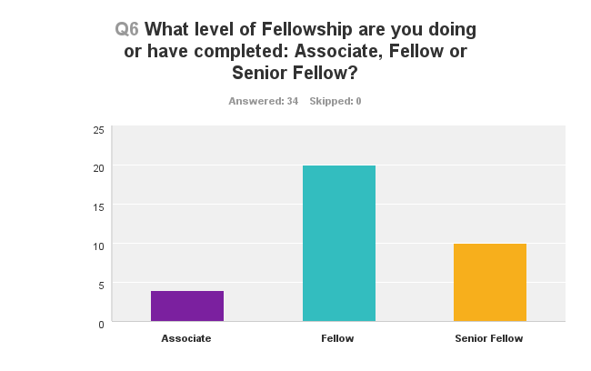

Slide 12
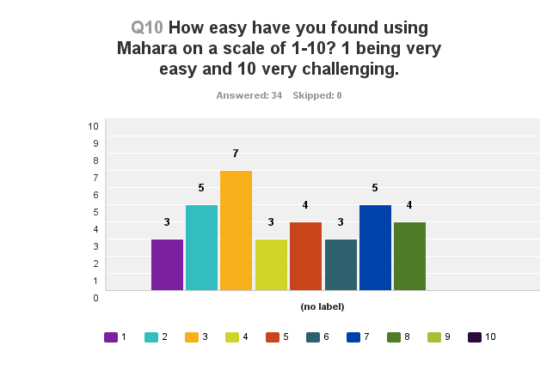

Slide 13
What do the staff think?
An evaluation into the use of the portfolio revealed the following:
Increased confidence in using e portfolios
Valuable as a reflective space to think about evidence
A few disliked it and wanted to be able to use an alternative platform

Slide 14
What did they say
It's been good for me to use the e-Portfolio in a real-world scenario, rather than simply exploring and testing its features for the benefit of teaching others.
I found it quite unintuitive at first and continued to be frustrated by some of its less flexible aspects, but soon got used to its overall use
I couldn't get on with it at all to begin with but Phil helped me a lot and I ended up really enjoying it

Slide 15
Mahara allowed for the "documentation" of and "drawing together" of evidence, to support the dialogic process. It gave me an opportunity to look back and reflect upon my achievement and plot my progression over time
It did precisely that - I found that thinking what to include in the e-portfolio made me reflect on what I had been doing and why
It took so long to get the stuff on in the right order [had to take everything off and number it]. The thinking had to be done before anything could go on Mahara as a finished product. No value for me in the thinking / developmental process which was all done outside the presentation of the portfolio

Slide 16
.. certainly the selection of content has been very useful as it challenges reflective process, raises many questions ( linking theory to practice),
it was a good platform for that, as it allowed small areas of text plus downloads of larger files plus photos to break it up and stimulate discussion
The process helped me to understand myself as a practitioner and provided ideas for future development work. A thoroughly enjoyable experience! Particularly the dialogue.
Certainly the process of pulling lots of things together for the dialogue process in response to the criteria was great in terms of me understanding aspects of what I have done and indeed, just how much I have done.

Slide 17
Factors that inhibit/enable staff engagement?
Inhibit
enable
Time pressure/work intensification
Lack of motivation
Lack of clear goals
Lack of understanding of the value
Technological problems
Senior management
Psychological as well as technological support
Role of the mentor
Personal determination
Flexibility
Feedback
Modelling
Deadlines
Notes:
From literature and the survey findings

Slide 18
Likelihood of continuing portfolio
Majority said yes!
Although!
In a folder within Microsoft
Using Word in My Documents
In other electronic ways

Slide 19
Final comments
I think the e-Portfolio is a good tool at this stage, Using it for SFHEA application provided me with an opportunity to use the tool in earnest, which I really enjoyed
The employment of Mahara to record personal achievement & development is both convenient & highly effective
If a constantly updated CPD is needed then time will need to be found to keep it up to date, this may be tricky in some areas

Slide 20
Discussion
Move your sheet to the next group.
Consider the third pair of questions.

Slide 21
Discussion
Return the dialogue sheet to its original group. Consider future actions you might take back to your institution.

Slide 22
References
Brockbank, A Beech, N & McGill, I (eds) (2002) Reflective Learning in Practice Aldershot UK : Gower
Chau J. Cheng, M (2010)Towards understanding the potential of e-portfolios for independent learning: A qualitative study Australasian Journal of Educational Technology, 2010, 26(7) 933-950
Jones, M. & Shelton, M. (2nd ed 2012) Developing your Portfolio. Enhancing your learning and showing your stuff , Routledge
Monica Leggett & Alison Bunker (2006) Teaching portfolios and university culture, Journal of Further and Higher Education, 30:3, 269-282,
Mok, J (2012) As a student I do think the attitude to the learning effectiveness of electronic portfolios depends, to quite a large extent on the attitude of the students. The electronic journal of e learning, vol 10, no 4 407-416
Parkes, K. & Kajdar, S (2010) Eliciting and Assessing Reflective Practice: A Case Study in Web 2.0 Technologies. International Journal of Teaching and Learning in Higher Education 2010, Volume 22, Number 2, 218-228
Parker, M. Ndoye, Ritzhapt, A. Qualitative Analysis of Student Perceptions of E-Portfolios in a Teacher Education Program. Volume 28 Number 3 | Journal of Digital Learning in Teacher Education
Sjorgen, E. Ragnemalm. Tingstrom, P. Uhlin, L. Abrandt Dahlgren, M. (2012) Academic reflections on the use of portfolio documentation of pedagogical skills. A pilot study .The Quality of Higher Education v 9, 98-119
Tisani, N. (2008) Challenges in producing a portfolio for
assessment: in search of underpinning educational theories, Teaching in Higher Education, 13:5, 549-557

Slide 23
Dialogue
Sheet
3. What strategies would you use to enhance staff engagement in using e-portfolios to demonstrate good standing and recognize future CPD?
3a. What challenges do you anticipate in engaging staff in using e portfolios in your own institution?
The sheet should now be returned to the original group.
Review the comments on your dialogue sheet. Are there any shared conclusions about the questions?
Consider what about future actions you might take back to your institution as a result of the discussions.
Group Name: ___
Room for
notes,
comments,
drawing,
etc.
Reflect on the comments of the previous group. Do you agree or disagree, do you have anything to add to their notes for question 1 or 2?
Read question 3 and as before discuss and make notes on the sheet.
5
This is a tool to create an exchange of ideas and thoughts.
4
The sheet is a notepaper – please write your thoughts on it. The group does not have to agree on a question, but all opinions should be heard and seen in the notes.
1. Start here
Reflect on the comments of the previous group. Do you agree or disagree, do you have anything to add to their notes for question 1?
Read question 2 and as before discuss and make notes on the sheet.
2
1a. E portfolios are a useful way of engaging staff to collect and reflect on evidence in a way that permits creativity?
Reflecting on staff engagement with e-portfolios.
The one who is closest to the question reads it aloud to the others – and makes the notes and a short summary of the discussion. Each question has 2 parts!
2. It is best to use e portfolios as a thinking space and/or as a formative opportunity.
3
1b. Staff engagement would be much better if a template was provided in the portfolio that linked to the dimensions of practice?
2. Summative assessment would change the way staff engaged with E-portfolios
www.teacherqualitytoolbox.eu

